Slide 1
FISCAL ANOMALY AND FRAUD DETECTON SYSTEM
STUDENT NAME: MOSES MAKUNGANYA JR
REGISTRATION NUMBER: 23311351012
PROGRAM: BACHELOR OF SCIENCE IN COMPUTER SCIENCE
GUIDE NAME: Mr MAXWELL PENSULO

Slide 2
ABSTRACT
With the rapid growth of digital payment systems and online business platforms, financial transaction monitoring has become increasingly important for ensuring transparency, compliance, and fraud prevention. Traditional fiscal systems mainly rely on manual reporting and rule based monitoring, which are often slow, inefficient, and unable to detect evolving fraudulent behaviors in real time. These limitations create challenges for businesses and regulatory authorities in maintaining accurate financial records and identifying suspicious activities.This project proposes a Cloud Based Fiscal Integration System with Machine Learning Based Anomaly Detection. The system is designed to collect, process, and monitor transaction data from business systems, POS platforms, and payment gateways in real time. Using machine learning algorithms such as Isolation Forest and Local Outlier Factor, the platform analyzes transaction patterns and detects unusual behaviors that may indicate fraud, tax evasion, or abnormal financial activities.The system will be implemented as a web based platform with secure user authentication and personalized dashboards for registered users. It will provide real time transaction monitoring, anomaly alerts, reporting tools, and data visualization features to improve decision making and compliance management. The backend will be developed using Node.js, the frontend using React, and the machine learning services using Python. Firebase or PostgreSQL will be used for secure cloud data storage.The proposed solution aims to improve financial transparency, enhance fraud detection capabilities, and provide businesses with an intelligent fiscal monitoring platform capable of adapting to modern digital transaction environments.

Slide 3
MODULE DESCRIPTION
Authentication Module
Handles user registration, login, password hashing, JWT authentication, and session management. Protects system routes and ensures secure access control for registered users. Provides user interfaces for account creation and login. Validates user credentials, handles authentication requests, and redirects authenticated users to their personalized dashboard.

Slide 4
CONT…
Analytics & Dashboard Module
This module provides real time visualization and analysis of transaction data through an interactive dashboard. It displays key metrics such as transaction volumes, revenue trends, anomaly statistics, and transaction status distributions using charts and summary cards. The module helps users monitor financial activities, identify suspicious patterns, and make informed decisions through clear graphical insights and live system updates.

Slide 5
CONT…
3. Anomaly Detection Module
This module uses machine learning algorithms to analyze transaction behavior and detect suspicious activities in real time. The Python FastAPI service processes transaction data using models such as Isolation Forest and Local Outlier Factor to identify anomalies and assign risk scores. The frontend interface displays flagged transactions, anomaly severity levels, and detailed justifications for each alert, helping users quickly identify and respond to potential fraud or abnormal financial behavior.

Slide 6
CONT…
4. Report Generation Module
This module enables users to generate and export transaction reports, anomaly summaries, and audit records in downloadable formats such as CSV and PDF. It provides filtering options based on date ranges, transaction status, and anomaly levels to support financial analysis and compliance reporting. The module helps users maintain accurate records, perform audits, and share structured reports for decision making and regulatory purposes.

Slide 7
CONT….
6. Transaction Management Module
This module manages all financial transactions in the system. It handles transaction creation, updates, retrieval, and deletion. It also supports external POS systems through secure API key integration for automatic transaction ingestion.

Slide 8
LITERATURE REVIEW
Author(s) | Title | Contribution to this project
A. J. Oliner, J. Stearley | What Supercomputers Say: A Study of Five System Logs | Provides real-world log patterns used to design effective log parsing and analysis.
A. Oliner, A. Ganapathi, W. Xu | Advances and Challenges in Log Analysis | Guides system design by highlighting key challenges in log analytics systems.
Shilin He et al. | A Survey on Automated Log Analysis for Reliability Engineering | Supports implementation of automated log processing and anomaly detection features.
Jeanderson B. Cândido et al. | Log-based Software Monitoring: A Systematic Mapping Study | Helps define core functionalities like monitoring, error tracking, and diagnosis.
Łukasz Korzeniowski & Krzysztof Goczyła | Landscape of Automated Log Analysis | Identifies essential components for building a complete log analytics architecture.
Tianzhu Zhang et al. | System Log Parsing: A Survey | Provides techniques for efficient log parsing and structuring in the system.

Slide 9
R. Ren et al. | LogMaster: Mining Event Correlations in Logs | Supports implementation of event correlation and trend detection features.
Liang Bao et al. | Execution Anomaly Detection in Large-Scale Systems | Guides anomaly detection logic for identifying unusual system behavior.
S. Alspaugh et al. | Analyzing Log Analysis: An Empirical Study of User Log Mining | Helps design user activity tracking and usage analytics features.
Dihia Lanasri | Query Logs Analytics: A Systematic Literature Review | Supports handling and analysis of query-based and structured log data.
Ramasankar Molleti | Analyzing Real-Time Application Logs for Decision Making | Reinforces need for real-time processing and dashboard visualization.
Guanyu Chen et al. | Understanding Log File Data from Educational Testing | Provides insights into extracting meaningful patterns from raw log data.
Edward Chuah et al. | Log-Correlation Tools for Cyberattack Detection | Supports implementation of security monitoring and threat detection features.
J. Miransky et al. | Operational-Log Analysis for Big Data Systems | Guides scalability and performance considerations for large log datasets.
S. Messaoudi et al. | Log Message Format Identification Techniques | Helps in designing log format recognition and preprocessing modules.

Slide 10
PLANNING FOR PROPOSED WORK
Review | Focus | Activities | Deliverables
First Review | Requirements and System Design | Identify system requirements, design system architecture, define database schema, and plan log parsing approach | Requirements document, system architecture diagrams, database schema
Second Review | System Development and Testing | Implement core modules including file upload, log parsing, data storage, analytics computation, and dashboard visualization. Conduct initial testing and debugging | Functional prototype, test results report, 50% documentation
Third Review | Final Implementation and Evaluation | Complete system integration, optimize performance, conduct final testing, evaluate system efficiency, and prepare presentation | Completed system, evaluation report, final presentation, final documentation

Slide 11
CONCLUSION
The Log Analytics Platform provides a comprehensive solution for collecting, processing, and analyzing log data from multiple sources in real-time. By transforming raw logs into actionable insights, it enables organizations to monitor system performance, detect errors, track user activity, and identify security threats efficiently. The modular architecture ensures scalability, ease of maintenance, and flexibility for future enhancements. Through interactive dashboards, automated alerts, and detailed reporting, the platform empowers decision-makers to respond proactively to operational issues. Overall, this project demonstrates the effectiveness of integrating data collection, processing, and analytics into a unified system to improve reliability, security, and performance across complex IT environments.

Slide 12
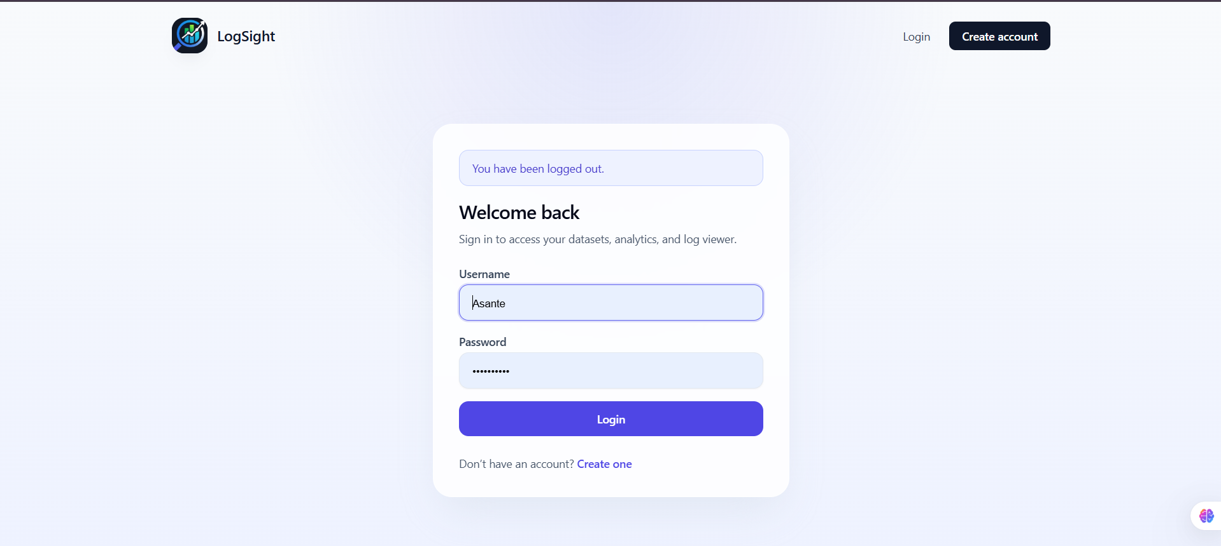
Authentication Module

Slide 13
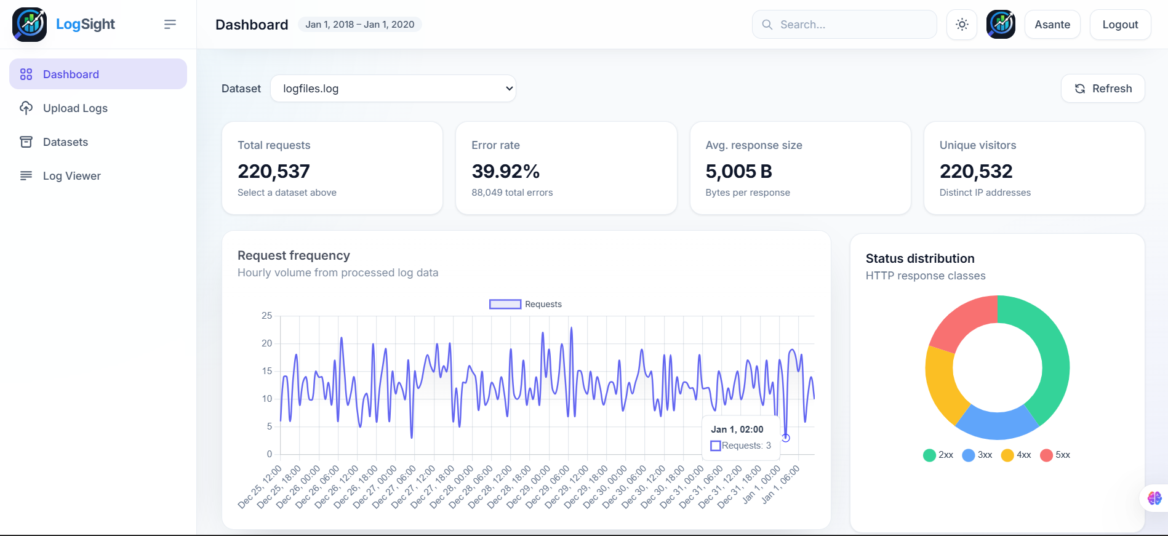
Analytics Module

Slide 14
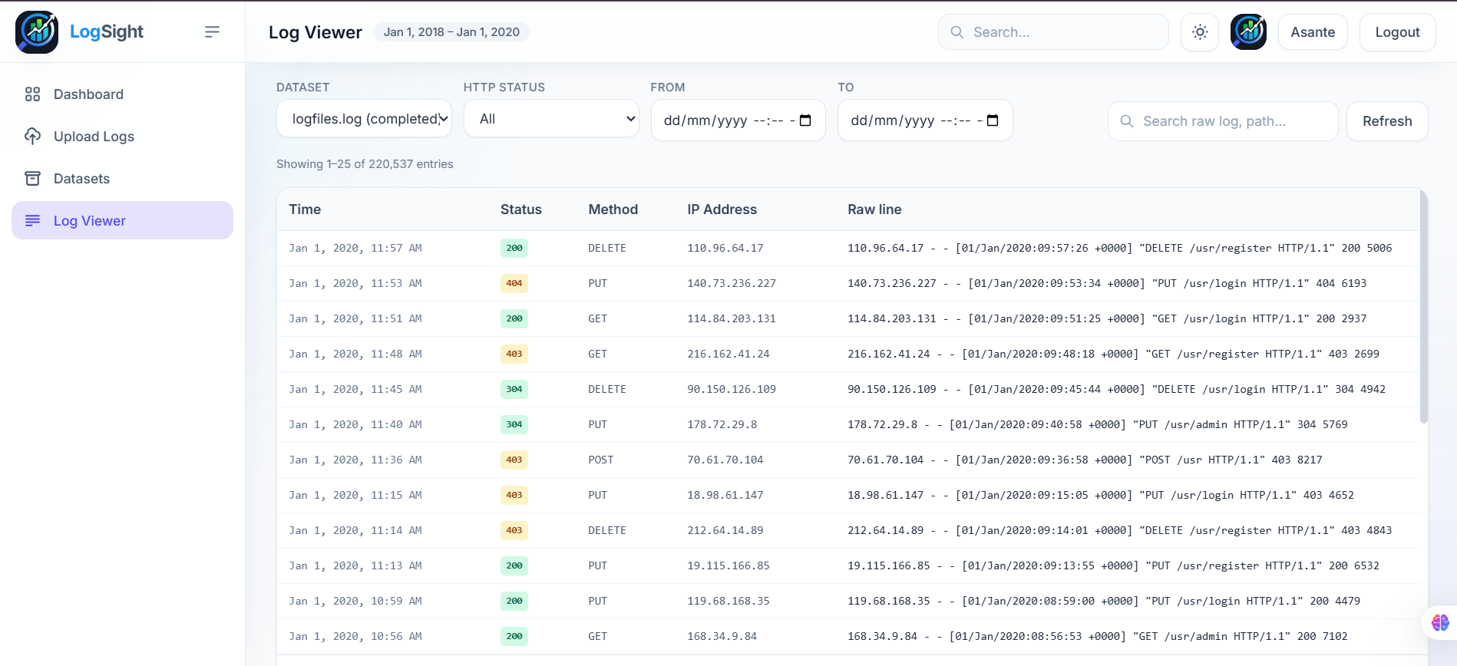
Log Viewer Module

Slide 15
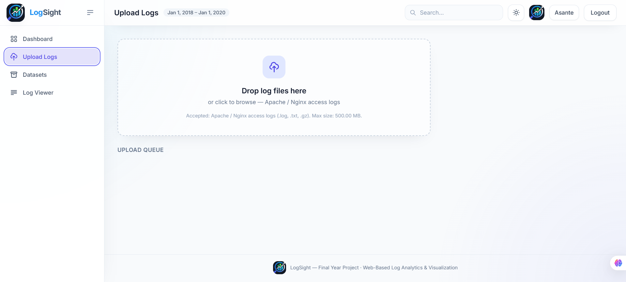
Log Parsing Module

Slide 16
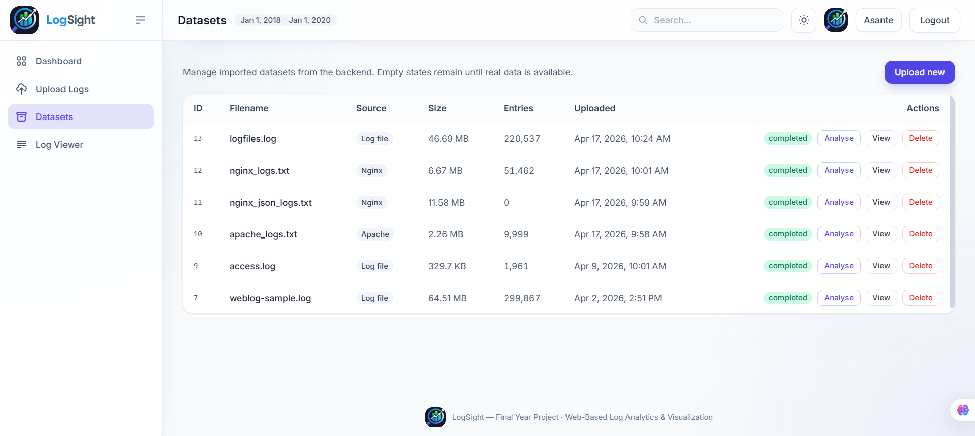
Dataset Management Module

